Slide 1

CanSat
A
mirkabir
University of
technology

Slide 2
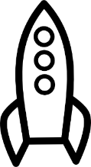

CanSat
A
mirkabir
University of
technology

Slide 3
Connecting to the cansat
CanSat
A
mirkabir
University of
technology

Slide 4
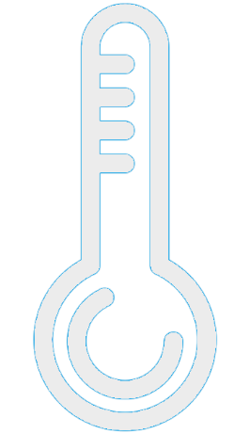
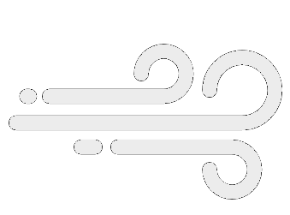

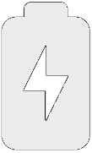



24.2 °C
23 °C
24.2 °C
25 °C
23 °C
24 °C
25 °C
24 °C
24.2 °C
24.2 °C
23 °C
23 °C
25 °C
25 °C
24 °C
24 °C
24.2 °C
24.2 °C
23 °C
23 °C
24.2 °C
23 °C
25 °C
25 °C
24 °C
24 °C
25 °C
24 °C
Pitch
Roll

Slide 5
23 °C
23 °C
23 °C
23 °C
23 °C
23 °C
23 °C
Pitch
Roll

